Slide 1

VIRTUAL BASED AUTONOMOUS VEHICLE
TEAM MEMBERS
HARIHARAN P (18A112)
SAM CLASTINE JESUMUTHU(19A515)

Slide 2
TABLE OF CONTENT
ABSTRACT
INTRODUCTION
SAE LEVEL OF AUTONOMY
ARCHITECTURE
KEY COMPONENTS
TESTING AND VALIDATION
SIMULATION
SCREENSHOTS
STEPS INVOLVED IN PROJECT
ADVANTAGES
CONCLUSION
REFRENCES

Slide 3
ABSTRACT
This project proposes a virtual based Autonomous vehicle and a testing environment where it will be evaluated.
The virtual environment fabricates the domain such like that it is the mimics of the activity of a genuine car.
Distinctive driving situations were utilized to analyze how the sensors respond when they are connected to genuine circumstances and are also utilized to confirm the impacts of other parameters on the scenes. Options are available to choose flexible sensors, monitor the output and implement any autonomous driving, steering prediction, deep learning and end-to-end learning algorithm.

Slide 4
INTRODUCTION
An autonomous car is a vehicle capable of sensing its environment and operating without human involvement.
A human passenger is not required to take control of the vehicle at any time, nor is a human passenger required to be present in the vehicle at all.
An autonomous car can go anywhere a traditional car goes and do everything that an experienced human driver does.

Slide 5
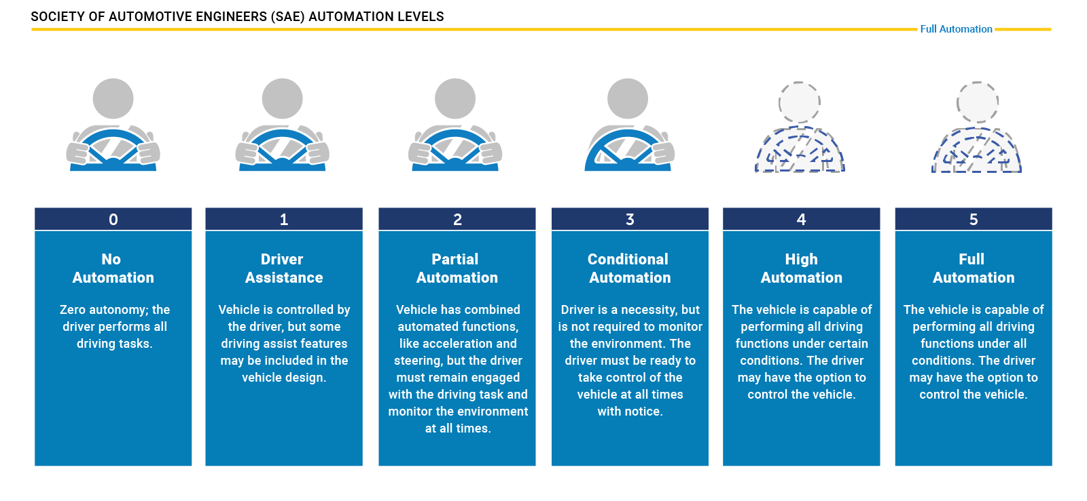
SAE Levels of Automation

Slide 6
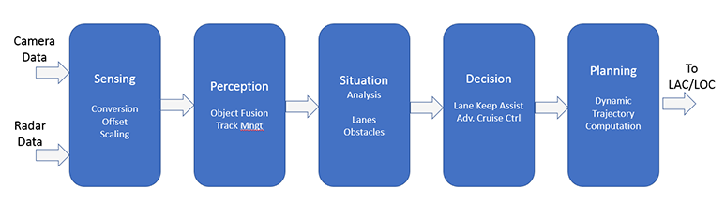
A typical Software architecture for Autonomous vehicle

Slide 7
Key Physical Components of Autonomous Vehicles
Cameras – Provide real-time obstacle detection to facilitate lane departure and track roadway information (like road signs).
Radar – Radio waves detect short & long-range depth.
LIDAR – Measures distance by illuminating target with pulsed laser light and measuring reflected pulses with sensors to create 3-D map of area.
GPS – Triangulates position of car using satellites.Current GPS technology is limited to a certain distance. Advanced GPS is in development.
Ultrasonic Sensors – Uses high-frequency sound waves and bounce-back to calculate distance. Best in close range.
Central Computer – “Brain” of the vehicle. Receives information from various components and helps direct vehicle overall.

Slide 9
Testing the Validation of Autonomous Vehicles: A Challenge
Unfortunately, testing the AVs in real environments, the most straight forward validation framework for system-level input-output behavior requires prohibitive amounts of time due to the rare nature of serious accidents.
Concretely, a recent study argues that AVs need to drive “hundreds of millions of miles and, under some scenarios, hundreds of billions of miles to create enough data to clearly demonstrate their safety”.
As a result, AV developers test extensively on public roads, potentially putting other road users at risk. In one such unfortunate event, Elaine Herzberg, 49, was killed by an Uber test vehicle on 18th March 2018 in Tempe, Arizona.

Slide 10
Simulation: An Effective Solution
The testing problem of the AVs can be transferred over to the virtual world, i.e., Simulation Environments. Realistic simulation environments comprising of high level-extensible modules like Environment module, Vehicle module, Physics engine, Sensor module, etc. provide an efficient solution for testing and validation of Autonomous Vehicles.
Modeling and simulation are well-established tools for analysis, design, acquisition, and training in the automotive domain.

Slide 11
SIMULATION ENVIRONMENT
Driving Simulators are usually a collection of high-level extensible modules that allow the rapid development and testing of vehicle configurations and facilitate the construction of complex traffic scenarios.
They support multiple vehicles with unique steering or acceleration limits, as well as unique tire parameters and dynamic profiles to name from the vast features they provide.
Engineers can specify the specific vehicle sensor systems and vary the time of day and weather conditions to generate robust data.
Non-vehicle participants such as cyclists and pedestrians can be assigned specified routes or script scenarios that place the ego vehicle in dangerous reactive scenarios .

Slide 12
CARLA: An Open Urban Driving Simulator
CARLA has been developed from the ground up to support the development, training, and validation of autonomous driving systems.
In addition to open-source code, and protocols, CARLA provides open digital assets (urban layouts, buildings, vehicles) that were created for this purpose, and can be used freely.
CARLA consists mainly of two modules, the CARLA Simulator and the CARLA Python API module.
The simulator does most of the heavy work, controls the logic, physics, and rendering of all the actors and sensors in the scene; it requires a machine with a dedicated GPU to run.

Slide 13
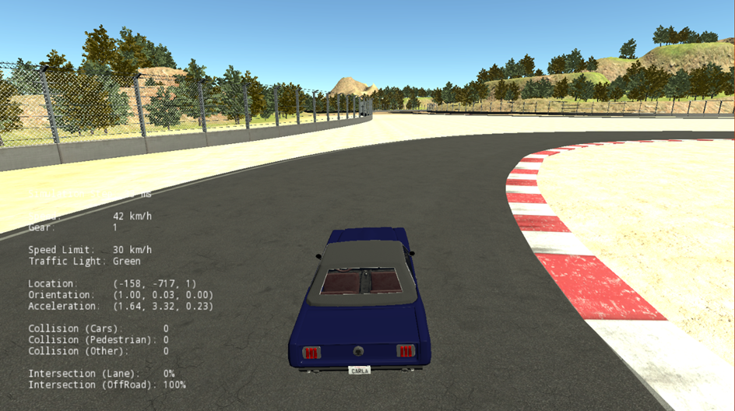
SCREENSHOTS

Slide 14
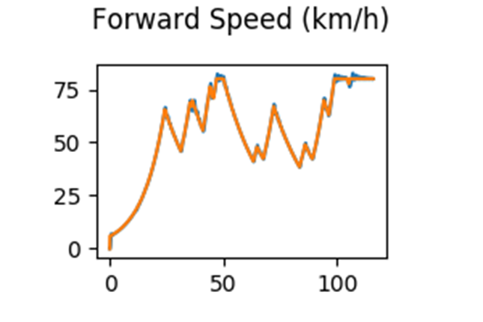
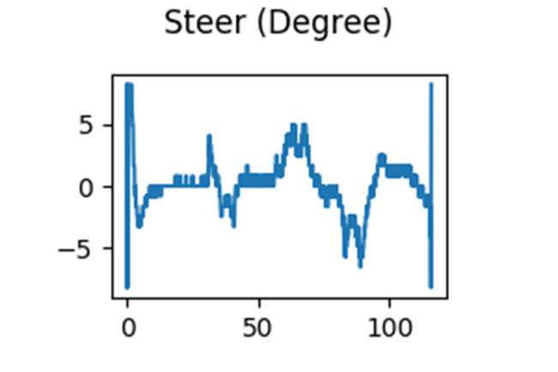

Slide 15
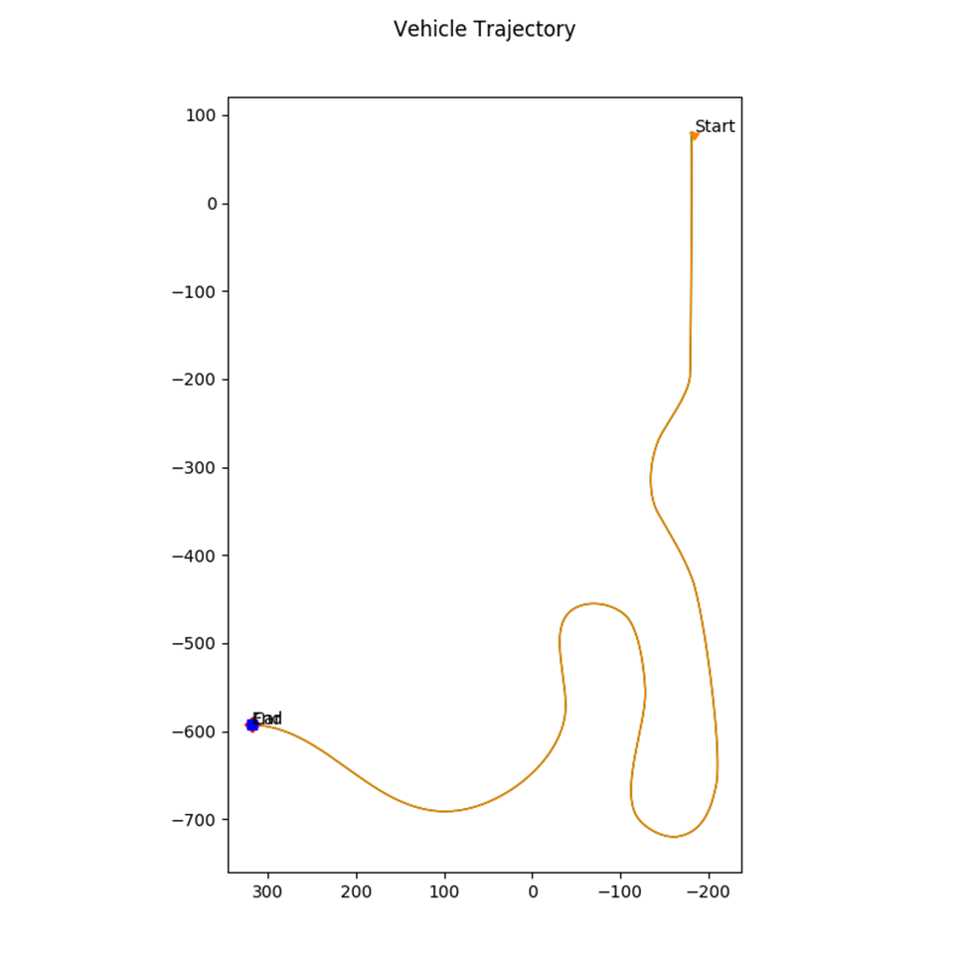
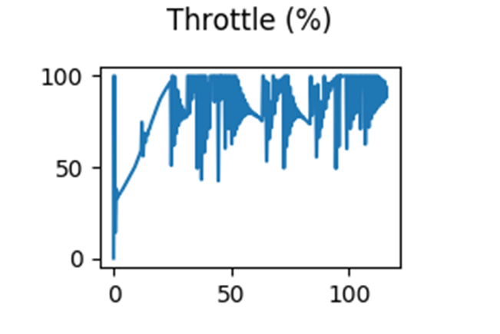

Slide 16
STEPS INVOLVED IN PROJECT
INSTALLING SIMULATOR AND IDE’S i.e Carla simulator and jupyter notebook/pycharm
Collecting training and testing dataset
Building a CNN model in deep learning for prediction
Testing the Model in CARLA simulator
Gathering errors
Rebuild and testing the model
Then the final output

Slide 17
ADVANTAGES
Environmentally Friendly
Improved Safety
Better Mobility
Better Use of a Driver’s Time
Better Traffic Management
Potential for New Design
Space Saving
Testing is safe in virtual environment and also at less cost and human effort

Slide 18
CONCLUSION
We conclude that we have presented a Simulation Environment with Reduced Reality Gap for data generation and testing Autonomous vehicle algorithms in a safe, fast, and cost-effective manner.
We have provided a proof of concept of how real traffic scenarios can be replicated quickly in the simulation environment.
We further demonstrated how those base scenarios can be edited and various complex test scenarios can be generated using the simulation environment set up in this work.

Slide 19
REFRENCES
"Self-driving Car Market Global Industry Trends, Share, Size and Forecast Report By 2023|With CAGR of 36.2%," Market Watch, 3 September 2019. [Online]. Available: https://www.marketwatch.com/press-release/self-driving-car-market-global-industry-trends-share-size-and-forecast-report-by-2023with-cagr-of-362-2019-09-03. [Accessed 16 November 2019].
R. Spence, "Everything you need to know about the future of self-driving cars," Maclean's, 11 July 2019. [Online]. Available: https://www.macleans.ca/society/technology/the-future-of-self-driving-cars/. [Accessed 16 November 2019].

Slide 20
Thank you

